Slide 1


PROJECT 2:
Bitcoin genie
Group 5
Coney dacanay
Chrishan de almeida

Slide 2

background
Bitcoin is fast becoming a globally accepted asset class.

Slide 3

background
Buy?
Sell?!
HODL?!?

Slide 4


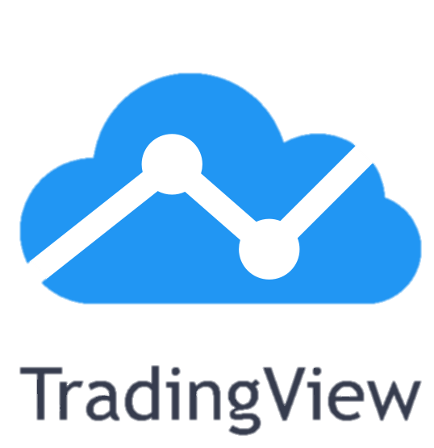
background
Bitcoin Sentiment Analysis on Social Media
Technical Analysis

Slide 5

background
Confusion…
Missed the boat…

Slide 6
background
Our Solution…

Slide 7
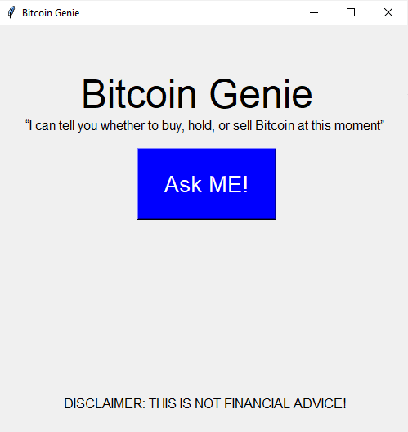
background
Our Solution…
Bitcoin genie

Slide 8

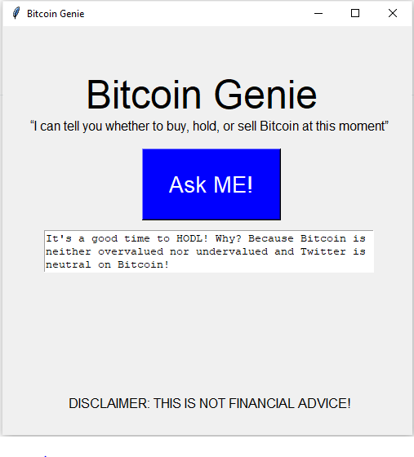
BITCOIN GENIe OFFERS…
Instant trade recommendations
AT THE CLICK OF A BUTTON.

Slide 9
How does it do this?
Bitcoin sentiment analysis using machine learning
Algorithmic technical analysis

Slide 10
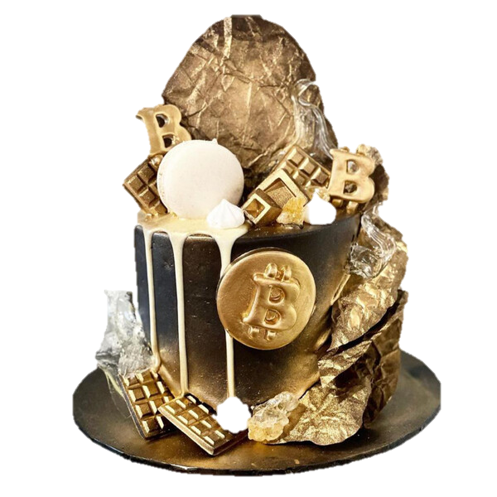


Cake experience roadmap
Wedding Cake
Trading bot that trades across all cryptocurrencies in your trading account
Conducts technical analysis using many sophisticated technical indicators
Conducts crypto sentiment analysis by scraping all social media platforms/new outlets
Birthday Cake
Trading bot that trades only Bitcoin in your trading account
Conducts technical analysis using only Bollinger bands and volume
Conducts Bitcoin sentiment analysis by scraping only Twitter
Cupcake
Advisor bot that offers instant trade recommendations only for Bitcoin.
Conducts technical analysis using only Bollinger bands
Conducts Bitcoin sentiment analysis by scraping only Twitter

Slide 11
Bitcoin genie’s method
Generates Trade Signals from Sentiment Analysis
Pulls most recent 200 “Bitcoin” tweets from Twitter API
Uses NLP to determine percentage of positive tweets and negative tweets
Positive tweet % > 50% = buy (bullish sentiment)
Negative tweet % > 50% = sell (bearish sentiment)
neither case = hodl (neutral sentiment)

Slide 12
Bitcoin genie’s method
Generates Trade Signals from Bollinger Band Analysis
Pulls live Bitcoin prices from Kraken API
Generates Bollinger Bands (past 20 days)
Price < lower band = buy (undervalued)
Price > upper band = sell (overvalued)
lower band < Price < upper band = hodl

Slide 13
Bitcoin genie’s method
Bitcoin Genie Decision Matrix
Bitcoin Sentiment Analysis Signals
 | Buy (Bullish) | Hodl (Neutral) | Sell (Bearish)
Buy (Undervalued) | Buy | Buy | Sell
Hodl (Average) | Buy | Hodl | Sell
Sell (Overvalued) | Buy | Sell | Sell
Technical Analysis Signals

Slide 14
Under the hood
Bitcoin genie’s code

Slide 15
Developer requirements
Some of the Modules/Libraries used:
Tweepy
Textblob
Time
Requests
Krakenex
Pandas
Tkinter

Slide 16
Post-mortem
Issues/Limitations Encountered
Limited time and resources
Too ambitious to build a sentiment analyzer in-house. Had to outsource.
Finnicky crypto practice trading accounts. Compatibility issues
Given 2 More Weeks…
Achieve ‘birthday cake design’
Trading bot connected to trading account
Incorporating more technical indicators
Build sentiment analyzer from scratch
Improve application aesthetic

Slide 17
Questions?
Thank you!

